Slide 1

Management Information Systems: Managing the Digital Firm
Seventeenth Edition, Global Edition
Chapter 6
Foundations of Business Intelligence: Databases and Information Management
Copyright © 2022, 2020, 2018 Pearson Education, Ltd. All Rights Reserved
Notes:
If this PowerPoint presentation contains mathematical equations, you may need to check that your computer has the following installed:
1) MathType Plugin
2) Math Player (free versions available)
3) NVDA Reader (free versions available)

Slide 2
Learning Objectives
6.1 What are the problems of managing data resources in a traditional file environment?
6.2 What are the major capabilities of database management systems (D B M S), and why is a relational D B M S so powerful?
6.3 What are the principal tools and technologies for accessing information from databases to improve business performance and decision making?
6.4 Why are data governance and data quality assurance essential for managing the firm’s data resources?
6.5 How will MIS help my career?
Notes:
This chapter discusses the role of databases for managing a firm’s data and providing the foundation for business intelligence. Ask students to describe any databases they have encountered or used at work or in their personal use on the web. For example, Google and Amazon are database-driven websites, as are travel reservation websites, and Facebook. Ask students why these sites are driven by databases—what is it about databases that makes the creation and use of these sites more efficient?

Slide 3
Video Cases
Case 1: Brooks Brothers Closes In on Omnichannel Retail
Case 2: Maruti Suzuki Business Intelligence and Enterprise Databases

Slide 4
Astro: Leveraging Data for Customer-driven Service
Problem
  Increasing local and international competition
  Data fragmented across multiple systems and files
Solutions
  Astro Data Lake
  Simple Storage Service
  Elastic Compute Cloud
Illustrates the importance of data management for better decision making and customer analysis

Slide 5
File Organization Terms and Concepts
Database: Group of related files
File: Group of records of same type
Record: Group of related fields
Field: Group of characters as word(s) or number(s)
Entity: Person, place, thing on which we store information
Attribute: Each characteristic, or quality, describing entity
Notes:
This slide describes a hierarchy of data that is used to store information in a database, progressing from the database as the top-level holder of information down through the field, which stores information about an entity’s attribute. This hierarchy is illustrated by the graphic on the next slide. Ask students to come up with some other entities that might be found in a university database (Student, Professor, etc.). What attributes (characteristics) would be important to store in the database?

Slide 6
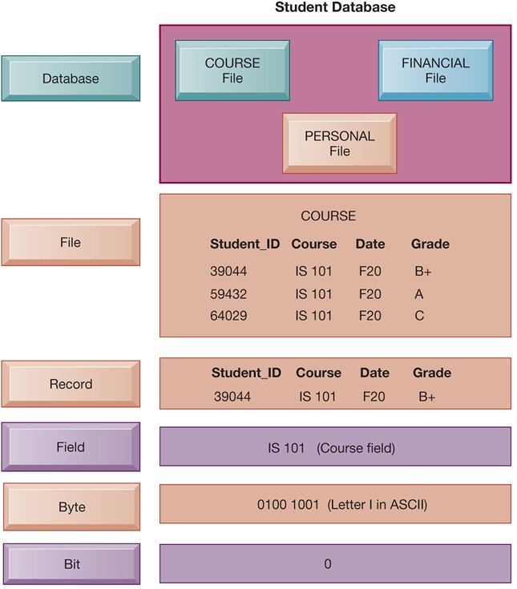
Figure 6.1 The Data Hierarchy
Notes:
Figure 6.1, Page 214.
A computer system organizes data in a hierarchy that starts with the bit, which represents either a 0 or a 1. Bits can be grouped to form a byte to represent one character, number, or symbol. Bytes can be grouped to form a field, and related fields can be grouped to form a record. Related records can be collected to form a file, and related files can be organized into a database.
This graphic illustrates the hierarchy of data found in a database. It shows the student course file grouped with files on students’ personal information and financial information that form the student database. It illustrates what data is found at each hierarchical level, from the database level down. Making up the smallest information unit, the field, are smaller units of data, common to all applications: bits and bytes. A bit stores a single binary digit, 0 or 1, and a byte stores a group of digits to represent a single character, number, or other symbol.
Alt Text
Long description: An illustration shows the hierarchy of a student database. The hierarchy of the database is as follows:
Level 1 is database which includes: Course file, financial file, and personal file.
Level 2 is file in which course is selected in the illustration. It has details of student ID, course, date, and grade.
Student ID: 39044; course, IS 101; Date, F20; Grade, B plus
Student ID: 59432; course, IS 101; Date, F20; Grade, A
Student ID: 64029; course, IS 101; Date, F20; Grade, C.
Level 3 is the record and includes the following details:
Student ID: 39044; course, IS 101; Date, F20; Grade, B plus.
Level 4 is the field. Here IS 101 is the course field.
Level 5 is the Byte: 0100 1001; Letter I in ASCII.
Level 6 is the Bit: 0.

Slide 7
Problems with the Traditional File Environment
Files maintained separately by different departments
Data redundancy
Data inconsistency
Program-data dependence
Lack of flexibility
Poor security
Lack of data sharing and availability
Notes:
This slide discusses the problems in data management that occur in a traditional file environment. In a traditional file environment, different functions in the business (accounting, finance, HR, etc.) maintained their own separate files and databases.
Ask students to describe further why data redundancy and inconsistency pose problems? What kinds of problems happen when data is redundant or inconsistent. Ask students to give an example of program-data dependence. What makes the traditional file environment inflexible?

Slide 8
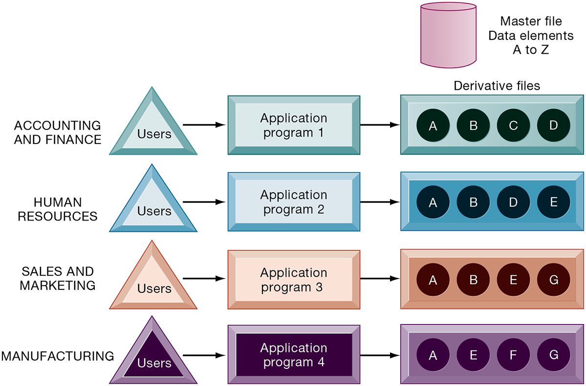
Figure 6.2 Traditional File Processing
Notes:
Figure 6.2, Page 215.
The use of a traditional approach to file processing encourages each functional area in a corporation to develop specialized applications. Each application requires a unique data file that is likely to be a subset of the master file. These subsets of the master file lead to data redundancy and inconsistency, processing inflexibility, and wasted storage resources.
This graphic illustrates a traditional environment, in which different business functions maintain separate data and applications to store and access that data. Ask students what kinds of data might be shared between accounting/finance and HR. What about between sales and marketing and manufacturing?
Alt Text
Long description: An illustration explains the concept of traditional file sharing. The details are as follows:
A master file with data elements A to Z is displayed in the illustration.
Through various departments, users, and application programs a linear flow is depicted to the derivate files. The corresponding details are as below:
Accounting and finance: Users, application program 1, derivative files (A, B, C, and D).
Human Resources: Users, application program 2, derivative files (A, B, D, and E).
Sales and Marketing: Users, application program 2, derivative files (A, B, E, and G).
Manufacturing: Users, application program 2, derivative files (A, E, F, and G).

Slide 9
Database Management Systems
Database
  Serves many applications by centralizing data and controlling redundant data
Database management system (D B M S)
  Interfaces between applications and physical data files
  Separates logical and physical views of data
  Solves problems of traditional file environment
    Controls redundancy
    Eliminates inconsistency
    Uncouples programs and data
    Enables organization to centrally manage data and data security
Notes:
This slide defines and describes databases and DBMS. Ask students to explain what the difference is between a database and a DBMS. What is the physical view of data? What is the logical view of data?

Slide 10
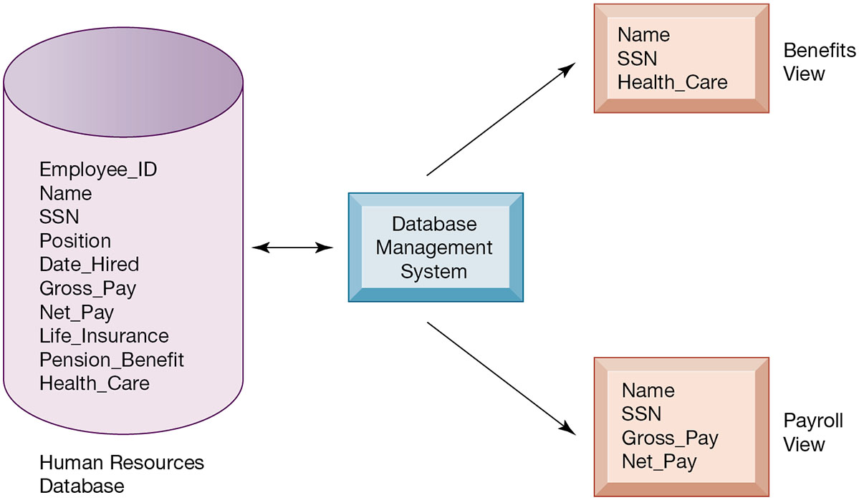
Figure 6.3 Human Resources Database with Multiple Views
Notes:
Figure 6.3, Page 217.
A single human resources database provides many different views of data, depending on the information requirements of the user. Illustrated here are two possible views, one of interest to a benefits specialist and one of interest to a member of the company’s payroll department.
This graphic illustrates what is meant by providing different logical views of data. The orange rectangles represent two different views in an HR database, one for reviewing employee benefits, the other for accessing payroll records. The students can think of the cylinder as the physical view, which shows how the data are actually organized and stored on the physical media. The physical data do not change, but a DBMS can create many different logical views to suit different needs of users.
Alt Text
Long description: A flow diagram illustrates the payroll view and benefits view of a human resources database. The human resource database comprising the below listed details is connected to the database management system through a bi-directional arrow:
Employee ID
Name
SSN
Position
Date Hired
Gross Pay
Net Pay
Life Insurance
Pension Benefit
Health Care
The database management system diverges into benefits view and payroll view.
Benefits view comprises of the name, SSN, and health care details
Payroll view comprises of the name, SSN, gross pay, and net pay details.

Slide 11
Relational D B M S
Represent data as two-dimensional tables
Each table contains data on entity and attributes
Table: grid of columns and rows
  Rows (tuples): Records for different entities
  Fields (columns): Represents attribute for entity
  Key field: Field used to uniquely identify each record
  Primary key: Field in table used for key fields
  Foreign key: Primary key used in second table as look-up field to identify records from original table
Notes:
This slide introduces the most common type of DBMS in use with PCs, servers, and mainframes today, the relational database. Ask students why these DBMS are called relational. Ask students for examples of RDBMS software popular today and if they have every used any of this software. You can walk students through an example database that you have prepared in Access or use one of the exercise data tables found at the end of the chapter. Identify rows, fields, and primary key.

Slide 12
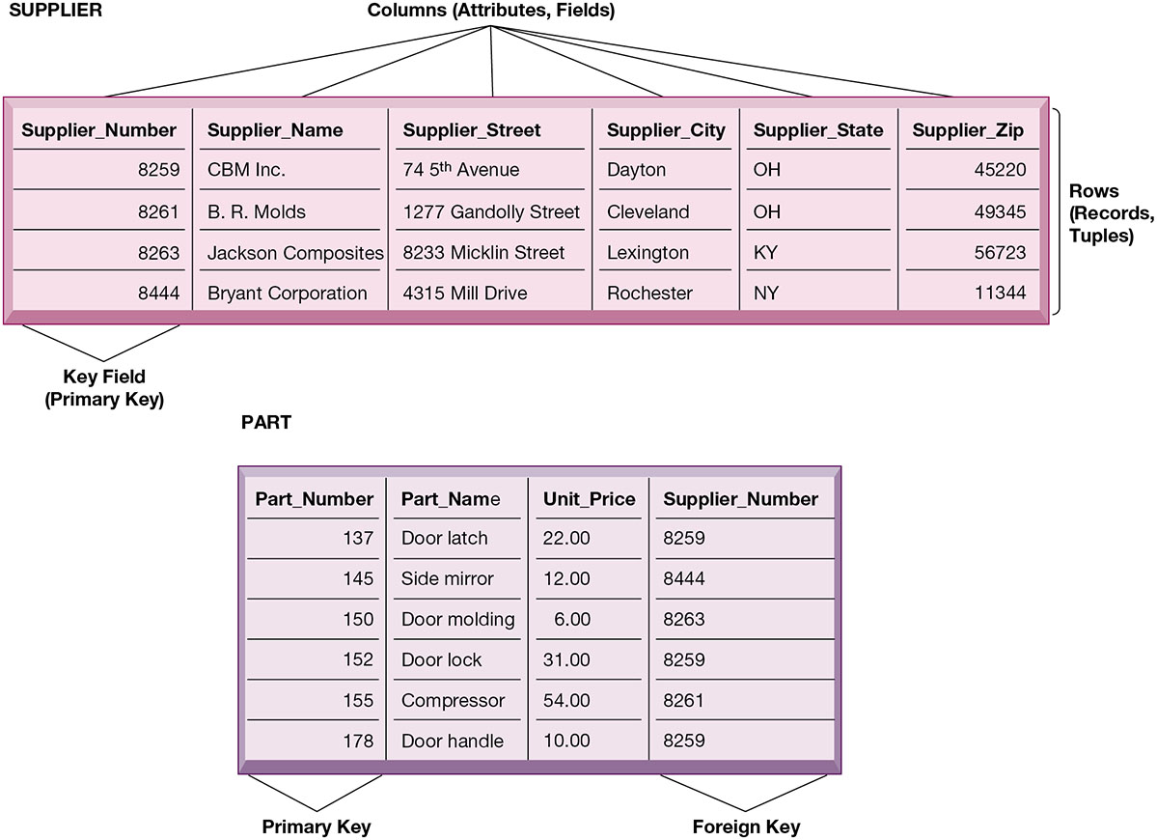
Figure 6.4 Relational Database Tables
Notes:
Figure 6.4, Page 219.
A relational database organizes data in the form of two-dimensional tables. Illustrated here are tables for the entities SUPPLIER and PART showing how they represent each entity and its attributes. Supplier_Number is a primary key for the SUPPLIER table and a foreign key for the PART table.
The graphic on this slide illustrates two tables in a relational DBMS. Ask students what the entity on this slide and the next are. The key field in the Supplier table is the Supplier number. What is the purpose of the key field?
Alt Text
Long description: Two relational database tables with sample data for entities Supplier and Part. The database table for supplier has 6 columns and 5 rows. The columns represent the attributes or fields, whereas the rows represent the records and tuples.
The column headings along with the sample data are summarized below:
Supplier number: 8259; Supplier name: CBM Inc.; Supplier street: 74 5th avenue; Supplier city: Dayton; Supplier state: Ohio; Supplier Zip: 45220.
Supplier number: 8261; Supplier name: B.R Molds.; Supplier street: 1277 Gandolly street; Supplier city: Cleveland; Supplier state: Ohio; Supplier Zip: 49345.
Supplier number: 8263; Supplier name: Jackson composites; Supplier street: 8233 Micklin street; Supplier city: Lexington; Supplier state: Kentucky; Supplier Zip: 56723.
Supplier number: 8444; Supplier name: Bryant Corporation; Supplier street: 4315 Mill drive; Supplier city: Rochester; Supplier state: New York; Supplier Zip: 11344.
The primary key or key field in the above database table is the supplier number.
The database table for part has 4 columns and 6 rows. The column headings along with the sample data are summarized below:
Part number: 137; Part name: Door latch; Unit price: 22.00; Supplier number: 8259
Part number: 145; Part name: Side mirror; Unit price: 12.00; Supplier number: 8444
Part number: 150; Part name: Door molding; Unit price: 6.00; Supplier number: 8263
Part number: 152; Part name: Door lock; Unit price: 31.00; Supplier number: 8259
Part number: 155; Part name: Compressor; Unit price: 54.00; Supplier number: 8261
Part number: 170; Part name: Door handle; Unit price: 10.00; Supplier number: 8259.
The primary key in the above table is the part number and the foreign key is the supplier number.

Slide 13
Operations of a Relational D B M S
Three basic operations used to develop useful sets of data
  SELECT
    Creates subset of data of all records that meet stated criteria
  JOIN
    Combines relational tables to provide user with more information than available in individual tables
  PROJECT
    Creates subset of columns in table, creating tables with only the information specified
Notes:
This slide describes how information is retrieved from a relational database. These operations (SELECT, JOIN, PROJECT) are like programming statements and are used by DBMS developers. For example, looking at the last two slides showing the Supplier and Parts table, you would use what kind of an operation to show the Parts records along with the appropriate supplier's name? Access has wizards for these commands.

Slide 14
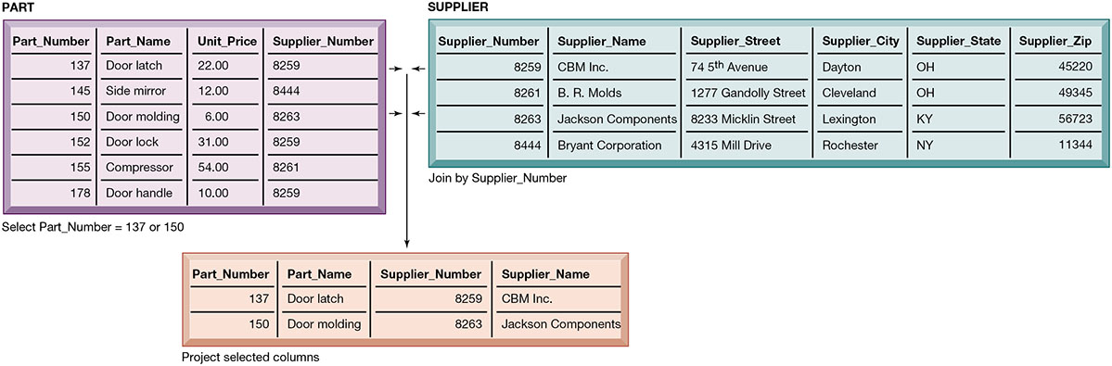
Figure 6.5 The Three Basic Operations of a Relational D B M S
Notes:
Figure 6.5, Page 220.
The select, join, and project operations enable data from two different tables to be combined and only selected attributes to be displayed.
This graphic illustrates the result from combining the SELECT, JOIN, and PROJECT operations to create a subset of data. The SELECT operation retrieves just those parts in the PART table whose part number is 137 or 150. The JOIN operation uses the foreign key of the Supplier Number provided by the PART table to locate supplier data from the Supplier Table for just those records selected in the SELECT operation. Finally, the PROJECT operation limits the columns to be shown to be simply the part number, part name, supplier number, and supplier name (orange rectangle).
Alt Text
Long description: Three tables illustrate the basic operations of a relational DBMS. The database table for supplier has 6 columns and 5 rows. The columns represent the attributes or fields, whereas the rows represent the records and tuples.
The column headings along with the sample data are summarized below:
Supplier number: 8259; Supplier name: CBM Inc.; Supplier street: 74 5th avenue; Supplier city: Dayton; Supplier state: Ohio; Supplier Zip: 45220.
Supplier number: 8261; Supplier name: B.R Molds.; Supplier street: 1277 Gandolly street; Supplier city: Cleveland; Supplier state: Ohio; Supplier Zip: 49345.
Supplier number: 8263; Supplier name: Jackson composites; Supplier street: 8233 Micklin street; Supplier city: Lexington; Supplier state: Kentucky; Supplier Zip: 56723.
Supplier number: 8444; Supplier name: Bryant Corporation; Supplier street: 4315 Mill drive; Supplier city: Rochester; Supplier state: New York; Supplier Zip: 11344.
The primary key or key field in the above database table is the supplier number.
The database table for part has 4 columns and 6 rows. The column headings along with the sample data are summarized below:
Part number: 137; Part name: Door latch; Unit price: 22.00; Supplier number: 8259
Part number: 145; Part name: Side mirror; Unit price: 12.00; Supplier number: 8444
Part number: 150; Part name: Door molding; Unit price: 6.00; Supplier number: 8263
Part number: 152; Part name: Door lock; Unit price: 31.00; Supplier number: 8259
Part number: 155; Part name: Compressor; Unit price: 54.00; Supplier number: 8261
Part number: 170; Part name: Door handle; Unit price: 10.00; Supplier number: 8259.
The primary key in the above table is the part number and the foreign key is the supplier number.
Part number 137 and 150 are selected and are joined by supplier number to give the below project selected columns table.
Part number: 137; Part name: Door latch; Supplier number: 8259; Supplier name: CBM Inc.
Part number: 150; Part name: Door molding; Supplier number: 8263; Supplier name: Jackson composites.

Slide 15
Capabilities of Database Management Systems
Data definition
Data dictionary
Querying and reporting
  Data manipulation language
    Structured Query Language (S Q L)
Many D B M S have report generation capabilities for creating polished reports (Microsoft Access)
Notes:
This slide discusses the three main capabilities of a DBMS: data definition, the data dictionary, and a data manipulation language.
Ask students to describe what characteristics of data would be stored by a data dictionary (name, description, size, type, format, other properties of a field). For a large company, a data dictionary might also store characteristics such as usage, ownership, authorization, security, users.
Note that the data manipulation language is the tool that requests operations such as SELECT and JOIN to be performed on data.

Slide 16
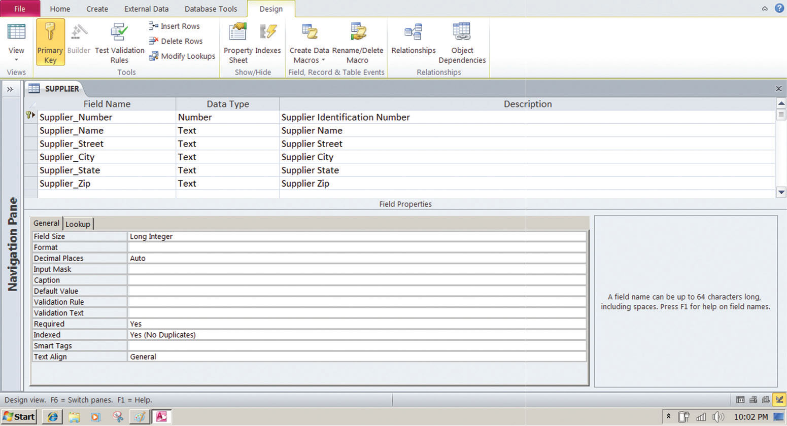
Figure 6.6 Access Data Dictionary Features
Notes:
Figure 6.6, Page 221.
Microsoft Access has a rudimentary data dictionary capability that displays information about the size, format, and other characteristics of each field in a database. Displayed here is the information maintained in the SUPPLIER table. The small key icon to the left of Supplier_Number indicates that it is a key field.
This graphic shows the data dictionary capability of Microsoft Access. For the field “Supplier Name” selected in the top pane, definitions can be configured in the General tab in the bottom pane. These General characteristics are Fields Size, Format, Input Mask, Caption, Default Value, Validation Rule, Validation Text, Required, Allow Zero Length, Indexed, Unicode Compression, IME mode, IME Sentence Mode, and Smart Tags.
Alt Text
Long description: A screenshot of a sample data dictionary. To access the data dictionary, the design tab is selected. Under the design tab are the following options:
Tools: Primary key; Builder; test validation rules; Insert rows; Delete rows; Modify lookups. The builder option is disabled.
Show or Hide: Property sheet and Indexes.
Field, record and table events: Create data macros; Rename or delete data macros.
Relationships: Relationships and object dependencies.
The data dictionary is divided into two horizontal panes. The first pane is labeled supplier and lists the database components such as field names, data types, and description in the form of a tabular list. The details are as below:
Field name: Supplier number; Data type: number; Description: Supplier identification number
Field name: Supplier name; Data type: Text; Description: Supplier name
Field name: Supplier street; Data type: Text; Description: Supplier street
Field name: Supplier city; Data type: Text; Description: Supplier city
Field name: Supplier state; Data type: Text; Description: Supplier state
Field name: Supplier zip; Data type: Text; Description: Supplier Zip.
The second pane is labeled field properties. This pane is divided into two sections. The section on the left has two tabs general and lookup. The lookup tab is selected. The details captured are listed below:
Field Size: Long integer
Format: NA
Decimal Places: Auto
Input Mask: NA
Caption: NA
Default value: NA
Validation Rule: NA
Validation Text: NA
Required: Yes
Indexed: Yes; No duplicates
Smart Tags: NA
Text Align: General.
The section on the right shows a data cell that reads: A field name can be 64 characters long, including spaces. Press F1 for help on field names.
Below the pane, the following is visible: Design view; F6 equals switch panes; F1 equals help.

Slide 17
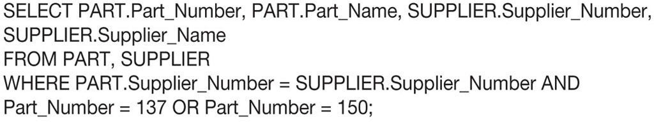
Figure 6.7 Example of an S Q L Query
Notes:
Figure 6.7, Page 221.
Illustrated here are the SQL statements for a query to select suppliers for parts 137 or 150. They produce a list with the same results as Figure 6.5.
This graphic shows an example SQL statement that would be used to retrieve data from a database. In this case, the SQL statement is retrieving records from the PART table illustrated on Slide 14 (Figure 6-5) whose Part Number is either 137 or 150.
Ask students to relate what each phrase of this statement is doing. (For example, the statement says to take the following columns: Part_Number, Part_Name, Supplier Number, Supplier Name, from the two tables Part and Supplier, when the following two conditions are true …)
Long description: A sample SQL query. The query reads as follows:
SELECT PART. Part underscore number, PART. Part underscore Name, SUPPLIER. Supplier underscore Number,
SUPPLIER. Supplier underscore Name
FROM PART, SUPPLIER
WHERE PART. Supplier underscore Number equals SUPPLIER. Supplier underscore Number AND
Part underscore Number equals 137 OR Part Underscore Number equals150

Slide 18
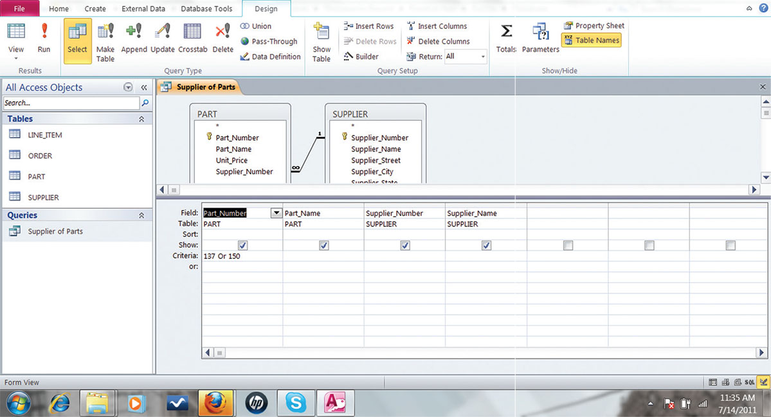
Figure 6.8 An Access Query
Notes:
Figure 6.8, Page 222.
Illustrated here is how the query in Figure 6.7 would be constructed using Microsoft Access querybuilding tools. It shows the tables, fields, and selection criteria used for the query.
This graphic illustrates a Microsoft Access query that performs the same operation as the SQL query in the last slide. The query pane at the bottom shows the fields that are requested (Fields), the relevant Tables (Table), the fields that will be displayed in the results (Show), and the criteria limiting the results to Part numbers 137 and 150 (Criteria).
Alt Text
Long description: A screenshot of a Microsoft Access window shows menu directions to create a query for the table. The window is divided into two panes. The pane on the left is labeled “All Access Objects” and has a search bar. It has two separate drop downs labeled tables and queries.
The tables dropdown lists the names of the tables, while the dropdown for queries lists the option supplier of parts query.
From the menu bar the design tab is selected which shows the following options:
Results: View and run.
Query type: Select, make table, upend, update, crosstab, delete, union, pass-through, and data definition. “Select” is highlighted in the screenshot.
Query set-up: Show table, insert rows, delete rows, builder, insert columns, delete columns, and drop-down labeled return displaying the option of all. Delete rows is in a disabled state.
Show or hide: Tools, parameters, property sheet and table names. “Table names” s selected here.
On the right side the screenshot is divided into two sections. The upper half section is labeled supplier or parts and shows two forms “Parts” and “Supplier”. An elbow connector is visible between the two forms. The “Parts” form has details pertaining to the part number, part name, unit price, and supplier number. The “Supplier” form has details pertaining to the supplier number, supplier name, supplier street, and so on.
The bottom half of the section is a table that details the following:
Field: Part number; Part name; Supplier number; Supplier name.
Table: Part; part; supplier; Supplier.
Sort: NA
Show: “Yes” to all. Depicted by tick marks in the checkboxes provided.
Criteria: 137 or 150.
The window is visible in the form view in the screenshot.

Slide 19
Designing Databases
Conceptual design vs. physical design
Normalization
  Streamlining complex groupings of data to minimize redundant data elements and awkward many-to-many relationships
Referential integrity
  Rules used by R D B M S to ensure relationships between tables remain consistent
Entity-relationship diagram
A correct data model is essential for a system serving the business well
Notes:
This slide describes activities involved in designing a database. To create an efficient database, you must know what the relationships are among the various data elements, the types of data that will be stored, and how the organization will need to manage the data. Note that the conceptual database design is concerned with how the data elements will be grouped, what data in what tables will make the most efficient organizations.

Slide 20
Figure 6.9 An Unnormalized Relation for Order
Notes:
Figure 6.9, Page 223.
An unnormalized relation contains repeating groups. For example, there can be many parts and suppliers for each order. There is only a one-to-one correspondence between Order_Number and Order_Date.
The graphics on this slide and the next illustrate the process of normalization. Here, one table lists the relevant data elements for the entity ORDER. These include all of the details about the order, the part, the supplier.
An order can include more than one part, and it may be that several parts are supplied by the same supplier. However, using this table, the supplier’s name, and other information might need to be stored several times on the order list.
Alt Text
Long description: A series of buttons illustrate the order before normalization. The sequence is as follows: order number, order date, part number, part name, unit price, part quantity, supplier number, supplier name, supplier street, supplier city, supplier state, supplier zip.

Slide 21
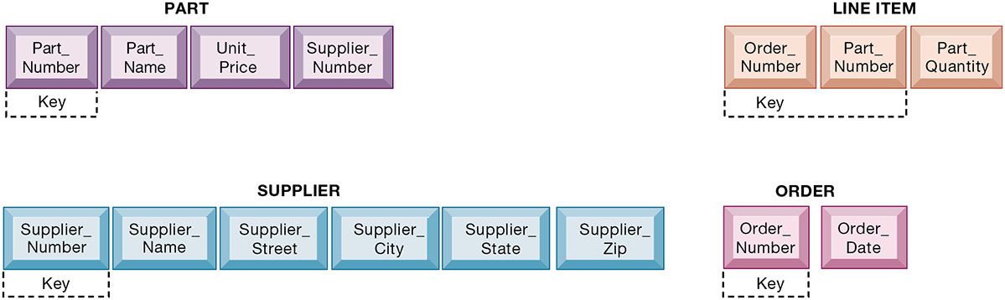
Figure 6.10 Normalized Tables Created from Order
Notes:
Figure 6.10, Page 223.
After normalization, the original relation ORDER has been broken down into four smaller relations. The relation ORDER is left with only two attributes, and the relation LINE_ITEM has a combined, or concatenated, key consisting of Order_Number and Part_Number.
This graphic shows the normalized tables. The Order table has been broken down into four smaller, related tables. Notice that the Order table contains only two unique attributes, Order Number and Order Date. The multiple items ordered are stored using the Line_Item table. The normalization means that very little data has to be duplicated when creating orders, most of the information can be retrieved by using keys to the Part and Supplier tables.
It is important to note that relational database systems try to enforce referential integrity rules to ensure that relationships between coupled tables remain consistent. When one table has a foreign key that points to another table, you may not add a record to the table with the foreign key unless there is a corresponding record in the linked table. For example, foreign key Supplier_Number links the PART table to the SUPPLIER table. Referential integrity means that a new part can’t be added to the part table without a valid supplier number existing in the Supplier table. It also means that if a supplier is deleted, any corresponding parts must be deleted also.
Alt Text
Long description: A series of buttons illustrate the order after normalization. The buttons are divided into four sequences as follows:
Part: Part number, part name, unit price, and supplier number. Here, part number is the key.
Line item: Order number, part number, and part quantity. Here, order number and part number are key.
Supplier: Supplier number, supplier name, supplier street, supplier city, supplier state, supplier zip. Here, supplier number is the key.
Order: Order number and order date. Here, order number is the key.

Slide 22
Figure 6.11 An Entity-Relationship Diagram
Notes:
Figure 6.11, Page 224.
This diagram shows the relationships between the entities SUPPLIER, PART, LINE_ITEM, and ORDER that might be used to model the database in Figure 6.10.
One technique database designers use in modeling the structure of the data is to use an entity-relationship diagram. Symbols on the diagram illustrate the types of relationships between entities. This graphic shows an example of an entity-relationship diagram. It shows that one ORDER can contain many LINE_ITEMs. (A PART can be ordered many times and appear many times as a line item in a single order.) Each LINE ITEM can contain only one PART. Each PART can have only one SUPPLIER, but many PARTs can be provided by the same SUPPLIER. Ask students what different types of relationships there are between entities (one-to-one, one-to-many, many-to-many).
Alt Text
Long description: A diagram shows the relationships between the entities Supplier, Part, Line Item, and Order. The details of the relationships between the various entities in the diagram are as follows:
Supplier to part: One-to-many
Part to supplier: One-to-one
Part to line item: One-to-one
Line item to part: One-to-many
Line item to order: One-to-one
Order to line item: One-to-many
The one-to-one relationship is depicted by two short marks and the one -to-many relationship is depicted by a crow’s foot topped by a short mark.
The sequence of the entity relationship diagram is explained in two ways as follows:
Supplier provides a part; part is ordered as per line item; line item belongs to an order.
Order includes line item; line item contains part; part is supplied by supplier.

Slide 23
Non-Relational Databases, Cloud Databases and Blockchain (Slide 1 of 3)
Non-relational databases: “No S Q L”
  More flexible data model
  Data sets stored across distributed machines
  Easier to scale
  Handle large volumes of unstructured and structured data
Notes:
This slide discusses other types of DBMS. Ask students why one would want to store social media data in a non-relational database? The answer: social media involves many different file types, and the information is not easily organized into tables of columns and rows. Another option for businesses is to license database software “from the cloud.” What would be an advantage to using a database service? (A primary answer is scalability—you pay only for the exact services you need.)

Slide 24
Non-Relational Databases, Cloud Databases and Blockchain (Slide 2 of 3)
Cloud databases
  Appeal to start-ups, smaller businesses
  Amazon Relational Database Service, Microsoft S Q L Azure
  Private clouds
Distributed databases
  Stored in multiple physical locations
  Example: Google Spanner
Notes:
This slide continues the discussion of other types of DBMS. Another option for businesses is to license database software “from the cloud.” What would be an advantage to using a database service? (A primary answer is scalability—you pay only for the exact services you need.)

Slide 25
Interactive Session: Technology: New Cloud Database Tools Help Vodafone Fiji Make Better Decisions
Class discussion
  Define the problem faced by Vodafone Fiji. What management, organization, and technology factors contributed to the problem?
  Evaluate Oracle Autonomous Data Warehouse and Oracle Analytics Cloud as a solution for Vodafone Fiji?
  How did the new Oracle tools change decision making at Vodafone Fiji?
  Was using cloud services advantageous for Vodafone Fiji? Explain your answer.

Slide 26
Non-relational Databases, Cloud Databases, and Blockchain (Slide 3 of 3)
Blockchain
  Distributed ledgers in a peer-to-peer distributed database
  Maintains a growing list of records and transactions shared by all
  Encryption used to identify participants and transactions
  Used for financial transactions, supply chain, and medical records
  Foundation of Bitcoin, and other crypto currencies
Notes:
Blockchain is a transaction database that uses encryption to ensure the validity of transactions among the parties in the system. Blockchain is discussed more fully in Chapter 8 Securing Information Systems.

Slide 27
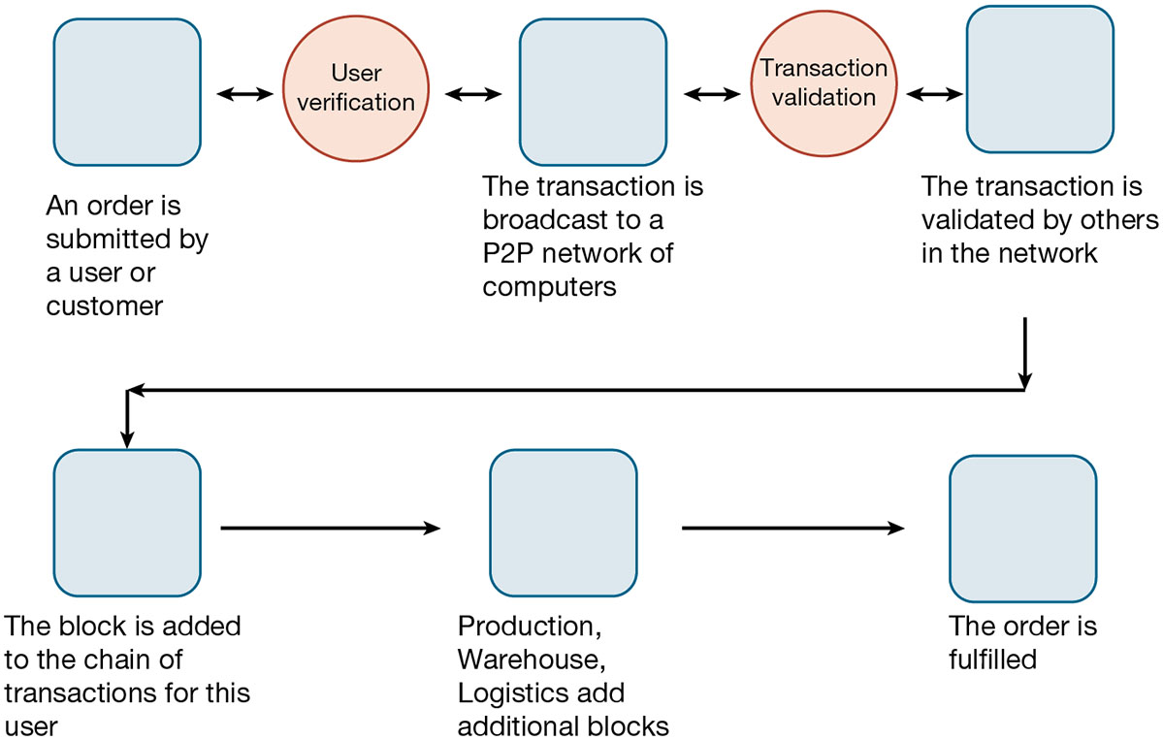
Figure 6.12 How Blockchain Works
Notes:
Figure 6.11, Page 227.
A blockchain system is a distributed database that records transactions in a peer-to-peer network of computers
Alt Text
Long description: A sequential flow diagram explains the concept of blockchain. The steps are as follows:
Step 1: An order is submitted by a user or customer
Step 2: The transaction is broadcast to a P2P network of computers
Step 3: The transaction is validated by others in the network
Step 4: The block is added to the chain of transactions for this user
Step 5: Production, warehouse, logistics add additional blocks
Step 6: The order is fulfilled.
Step 1 and 2 are interconnected by the process of user verification, while step 2 and 3 are interconnected by the process of transaction validation. The steps are depicted as blocks, while the processes are represented as circles in the diagram. The interconnection is depicted via bidirectional arrows.

Slide 28
The Challenge of Big Data
Big data
  Massive sets of unstructured/semi-structured data from web traffic, social media, sensors, and so on
Volumes too great for typical D B M S
  Petabytes, exabytes of data
Can reveal more patterns, relationships and anomalies
Requires new tools and technologies to manage and analyze
Notes:
This slide discusses how very large databases are used to produce valuable information for firms. The text gives the example of Shutterstock, a global online image marketplace with over 24 million images, which. by analyzing big data, is able to find out where its website visitors place their cursors and how long they hover over an image before making a purchase.

Slide 29
Interactive Session: Management: Big Data Baseball
Class discussion
  How did information technology change the game of baseball? Explain.
  How did information technology affect decision making at MLB teams? What kind of decisions changed as the result of using big data?
  How much should baseball rely on big data and analytics?

Slide 30
Business Intelligence Infrastructure (1 of 4)
Array of tools for obtaining information from separate systems and from big data
  Data warehouse
  Data mart
  Hadoop
  In-memory computing
  Analytical platforms
Notes:
Business intelligence is a very amorphous notion that is not well defined. In this course we refer instead to a “business intelligence” environment which is composed of many different components (including both technology and management dimensions).

Slide 31
Business Intelligence Infrastructure (2 of 4)
Data warehouse
  Stores current and historical data from many core operational transaction systems
  Consolidates and standardizes information for use across enterprise, but data cannot be altered
  Provides analysis and reporting tools
Data marts
  Subset of data warehouse
  Typically focus on single subject or line of business
Notes:
This slide discusses the use of data warehouses and data marts by firms. Ask students why having a data warehouse is an advantage for firms hoping to perform business analyses on the data? Why does there have to be a repository of data that is separate from the transaction database?

Slide 32
Business Intelligence Infrastructure (3 of 4)
Hadoop
  Enables distributed parallel processing of big data across inexpensive computers
  Key services
    Hadoop Distributed File System (H D F S): data storage
    MapReduce: breaks data into clusters for work
    Hbase: No S Q L database
  Used by Yahoo, NextBio
Notes:
Hadoop is one of the tools used by search engines such as Google and Bing to rapidly search billions of web pages and find those which appear to be the most relevant to a user’s search query. This task is accomplished in a few milliseconds by distributing the data and the processing across tens of thousands of processors, and then pulling the results together to produce a web search page for users. Hadoop is far faster than SQL and traditional centralized databases running on very large mainframes or supercomputers. Hadoop is an open source software library.

Slide 33
Business Intelligence Infrastructure (4 of 4)
In-memory computing
  Used in big data analysis
  Uses computers main memory (R A M) for data storage to avoid delays in retrieving data from disk storage
  Can reduce hours/days of processing to seconds
  Requires optimized hardware
Analytic platforms
  High-speed platforms using both relational and non-relational tools optimized for large datasets

Slide 34
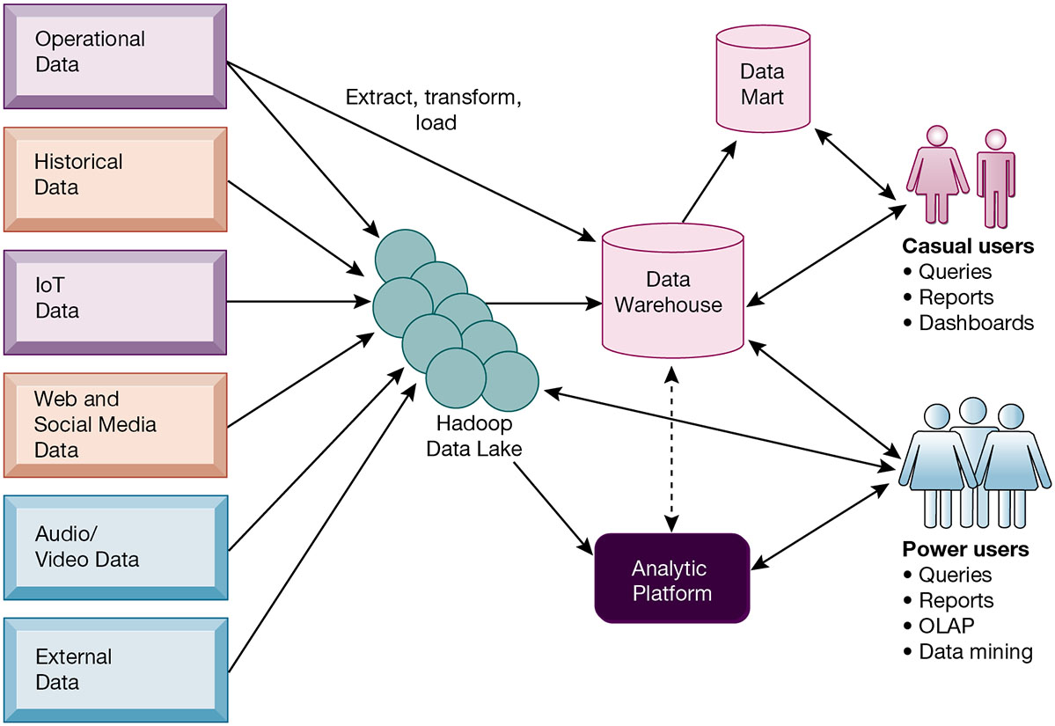
Figure 6.13 Contemporary Business Intelligence Infrastructure
Notes:
Figure 6.12, Page 233.
A contemporary business intelligence infrastructure features capabilities and tools to manage and analyze large quantities and different types of data from multiple sources. Easy-to-use query and reporting tools for casual business users and more sophisticated analytical toolsets for power users are included.
This graphic illustrates the components of a contemporary business intelligence infrastructure. It shows that the data warehouse extracts data from multiple sources, both internal and external, including a Hadoop data lake, and transforms it as needed for the business intelligence systems. An analytic platform has tools for power users, including reporting, OLAP, and data mining, to extract meaningful information from the data warehouse and Hadoop data lake. A subset of the data warehouse is collected in a data mart for casual groups of users.
Alt Text
Long description: An illustration explains the components of a contemporary business intelligence infrastructure. At the center of the illustration is the data warehouse, which is connected to the Hadoop data lake. The Hadoop data lake comprises of the following data:
Operational
Historical
IOT
Web and social media
Audio and video
External
The operational data from the above list is directly connected to the data warehouse to extract, transform, and load data. The data warehouse is additionally connected to the data mart.
The data mart is interconnected to casual users who generate queries, reports, and dashboards. The casual users are interconnected to the data warehouse as well. Here, the interconnectedness is depicted through a solid bidirectional arrow.
The Hadoop data lake is also connected to the analytic platform, which in turn is interconnected to the data warehouse. The interconnectedness is depicted through a dashed bidirectional arrow.
The analytic platform is interconnected to power users who generate queries, reports, OLAP, and perform data mining. The power users are also directly interconnected to the data warehouse and the Hadoop data lake as well. Here, the interconnectedness is depicted through a solid bidirectional arrow.

Slide 35
Analytical Tools: Relationships, Patterns, Trends
Tools for consolidating, analyzing, and providing access to vast amounts of data to help users make better business decisions
  Multidimensional data analysis (O L A P)
  Data mining
  Text mining
  Web mining
Notes:
This slide describes the role and types of analytical tools and techniques for finding useful information and relationships in large data sets.

Slide 36
Online Analytical Processing (O L A P)
Supports multidimensional data analysis
  Viewing data using multiple dimensions
  Each aspect of information (product, pricing, cost, region, time period) is different dimension
  Example: How many washers sold in the East in June compared to the sales forecast?
O L A P enables rapid, online answers to ad hoc queries
Notes:
This slide discusses online analytical processing, one of the three principal tools for gathering business intelligence. Ask students to come up with additional examples of what a multidimensional query might be.

Slide 37
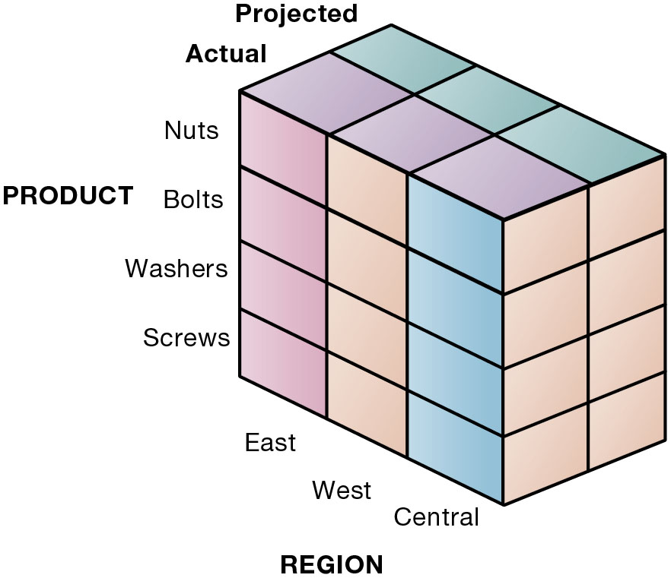
Figure 6.14 Multidimensional Data Model
Notes:
Figure 6.14, Page 234.
This view shows product versus region. If you rotate the cube 90 degrees, the face that will show is product versus actual and projected sales. If you rotate the cube 90 degrees again, you will see region versus actual and projected sales. Other views are possible.
This graphic illustrates the concept of dimensions as it relates to data. Product is one dimension. East is a dimension and projected and actual sales are two more dimensions. Altogether, we are trying to analyze four dimensions. The business question is: In the Eastern region, what are the actual and projected sales of our products (nuts, bolts, washers, and screws)? Sometimes referred to as a “data cube,” the graphic can depict this four-dimensional view of the data. More importantly, when compared to a spreadsheet model of the same data, a graphical data cube is much faster, easier to understand and visualize the relationships.
Alt Text
Long description: A three-dimensional matrix in the form a cuboid, compares actual and projected sales for four products across three regions. The four products are nuts, bolts, washers, and screws represented along the vertical dimension in the matrix. The regions are east, west, and central along one of the horizontal dimensions, while the other represents projected and actual sales.

Slide 38
Data Mining
Finds hidden patterns, relationships in datasets
  Example: customer buying patterns
Infers rules to predict future behavior
Types of information obtainable from data mining:
  Associations
  Sequences
  Classification
  Clustering
  Forecasting
Notes:
This slide discusses another business intelligence tool driven by databases, data mining. Data mining provides insights into data that cannot be discovered through OLAP, by inferring rules from patterns in data. Ask students to describe the types of information listed:
Associations: Occurrences linked to single event
Sequences: Events linked over time
Classification: Recognizes patterns that describe group to which item belongs
Clustering: Similar to classification when no groups have been defined; finds groupings within data
Forecasting: Uses series of existing values to forecast what other values will be

Slide 39
Text Mining and Web Mining
Text mining
  Extracts key elements from large unstructured text data sets
  Sentiment analysis software
Web mining
  Discovery and analysis of useful patterns and information from web
  Web content mining
  Web structure mining
  Web usage mining
Notes:
Whereas data mining describes analysis of data in databases, there are other types of information that can be “mined,” such as text mining and web mining. Ask students what other types of unstructured textual data sets a company might store, and what kind of useful information might be extracted from them.
This slide continues the exploration of mining stored data for valuable information. In addition to text mining, there are several ways to mine information on the web. The text uses the example of marketers using the Google Trends service, which track the popularity of various words and phrases used in Google search queries, to learn what people are interested in and what they are interested in buying. What type of web mining is this? Why might a marketer be interested in the number of web pages that link to a site.

Slide 40
Databases and the Web
Many companies use the web to make some internal databases available to customers or partners
Typical configuration includes:
  Web server
  Application server/middleware/scripts
  Database server (hosting D B M S)
Advantages of using the web for database access:
  Ease of use of browser software
  Web interface requires few or no changes to database
  Inexpensive to add web interface to system
Notes:
This slide looks at how companies utilize the web to access company databases. Ask students to describe the flow of information from a company’s databases to the web page a user is accessing data on. Why is browser software easy to use? Why is it less expensive to add a web interface to a database-driven information system?

Slide 41
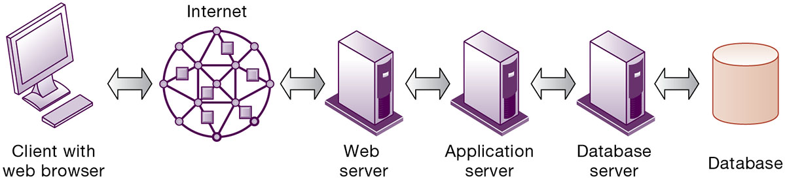
Figure 6.15 Linking Internal Databases to the Web
Notes:
Figure 6.15, Page 236.
Users access an organization’s internal database through the web using their desktop PC browsers or mobile apps.
Alt Text
Long description: A linear flow diagram explains how users access an internal database through the web using their desktop computers. The flow from left to right is as follows:
Client with web browser
Internet
Web server
Application server
Database server
Database
All these are interconnected via bidirectional arrows in the flow diagram.

Slide 42
Data Governance
Data governance
  Encompasses policies and procedures through which data can be managed as an organizational resource.
  Establishes rules for sharing, disseminating, acquiring, standardizing, classifying and inventorying information
    Example: Firm information policy that specifies that only selected members of a particular department can view certain information
Notes:
This slide discusses the firm’s need for data governance in order to ensure that firm data is accurate, reliable, and readily available to those who need it.

Slide 43
Data Quality Assurance
More than 25 percent of critical data in Fortune 1000 company databases are inaccurate or incomplete
Before new database is in place, a firm must:
  Identify and correct faulty data
  Establish better routines for editing data once database in operation
Data quality audit
Data cleansing
Notes:
This slide discusses the importance of data quality. Ask students for personal examples of what happens when a company’s data is faulty. The text provides an example of one study finding that 10 to 25 percent of customer and prospect records contain critical data errors. Has anyone in class directly experienced a problem with the accuracy of data about them stored on computer systems?

Slide 44
How Will M I S Help My Career?
The Company: Mega Midwest Power
Position Description: Entry-level data analyst
Job Requirements
Interview Questions
Author Tips
Notes:
A good opportunity for a class discussion on how MIS will help students with their current or future careers. Would any in the class be interested in a job like this? What do they think are the most important skills the employer is looking for? How would they answer the interviewer questions?

Slide 45

Copyright
This work is protected by United States copyright laws and is provided solely for the use of instructors in teaching their courses and assessing student learning. Dissemination or sale of any part of this work (including on the World Wide Web) will destroy the integrity of the work and is not permitted. The work and materials from it should never be made available to students except by instructors using the accompanying text in their classes. All recipients of this work are expected to abide by these restrictions and to honor the intended pedagogical purposes and the needs of other instructors who rely on these materials.

